Slide 1


A quantitative evaluation of Optical vs. SAR-based Wave Kinematic Bathymetry
An algorithm for deriving nearshore depth in the surf-zone from satellite imagery
By Marcel Rodriguez-Riccelli

Slide 2
STEP 1: DETERMINE FOUR AREAS OF INTEREST
CONDITIONS
VARIATION
Publicly accessible hydrographic shallow water survey data
Swell-wave regime
Negligible effects from currents
An extended nearshore region of depths below 100 m
Latitude
Turbidity
Exposure to marine processes
Depositional / Erosional
Seafloor features
Reef, sandbar, canyon…

Slide 3
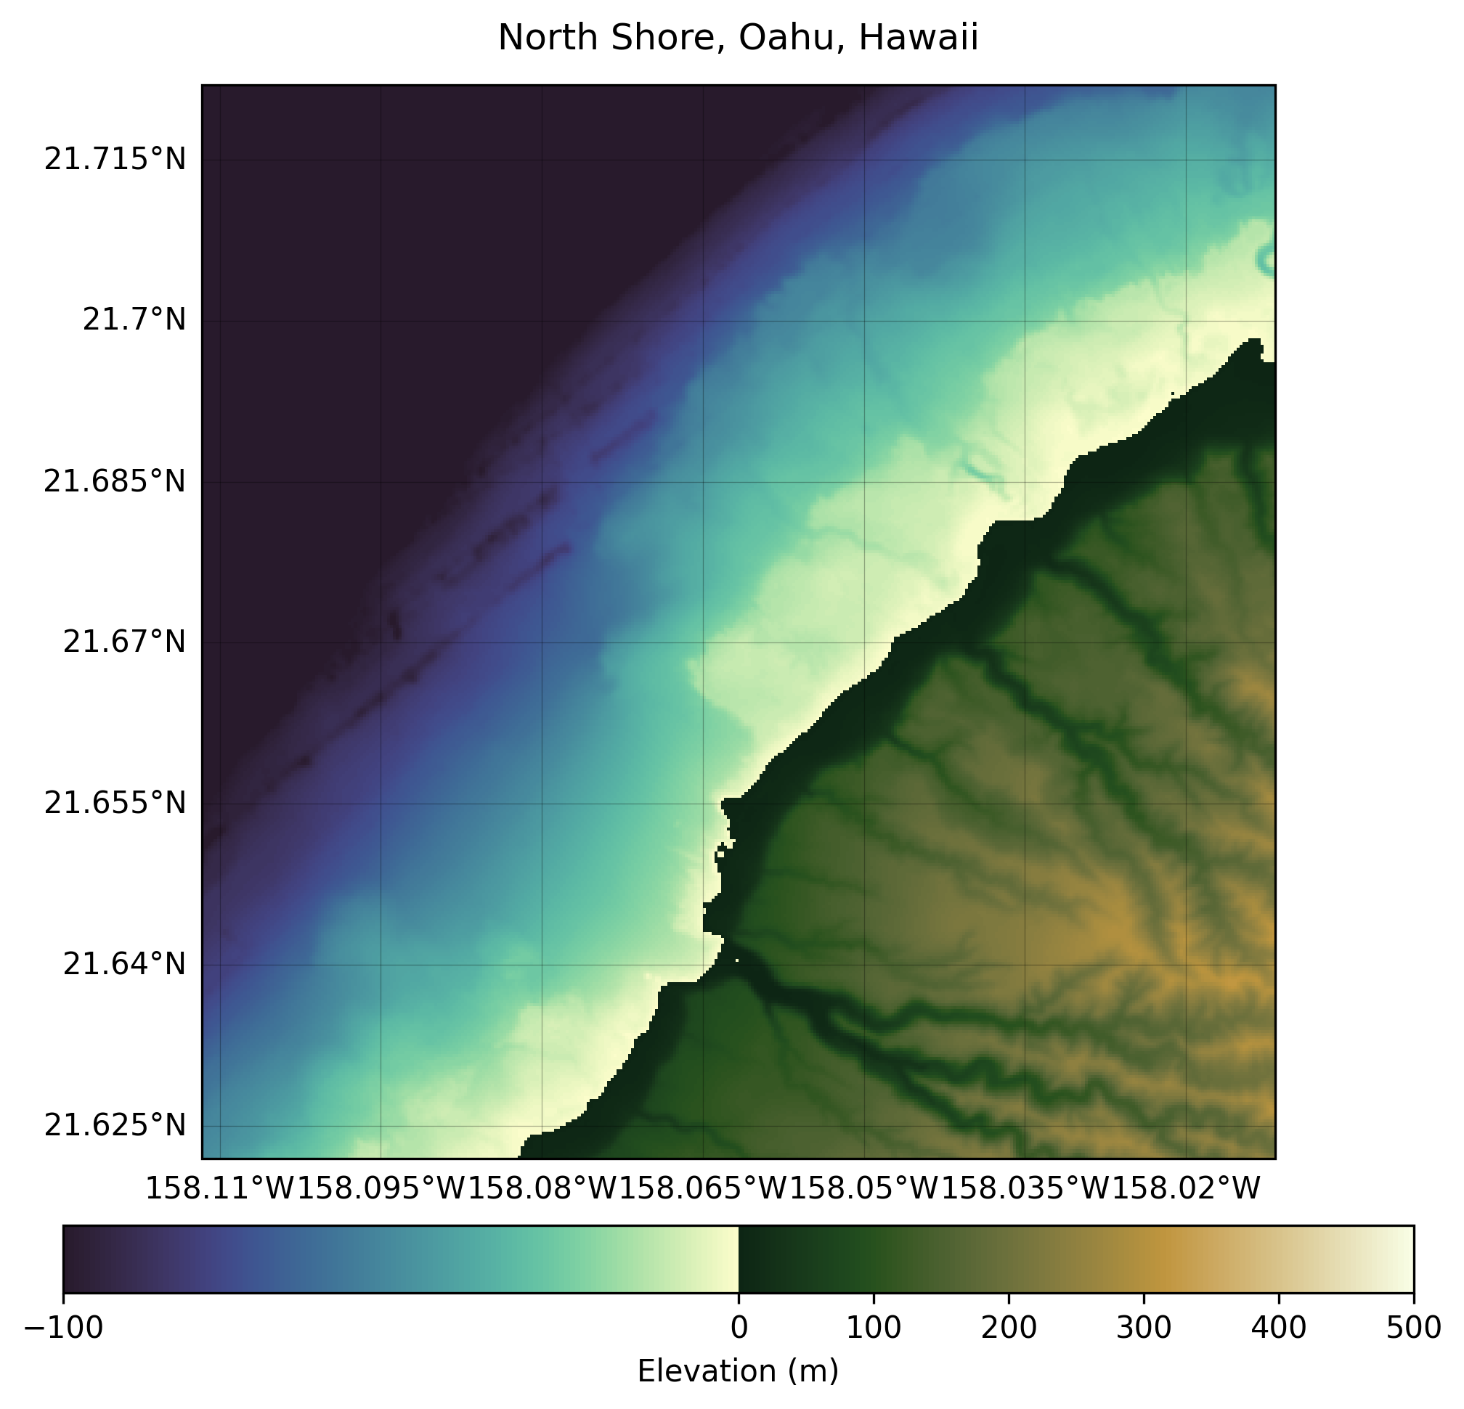
STEP 1: DETERMINE FOUR AREAS OF INTEREST
1. NORTH SHORE OF O’AHU, HAWAII
21°40'19"N 158°03'42"W
Flat tabletop reef, lava spires
Highly energetic, erosional, especially in winter
Highly sloped
Low turbidity

Slide 4
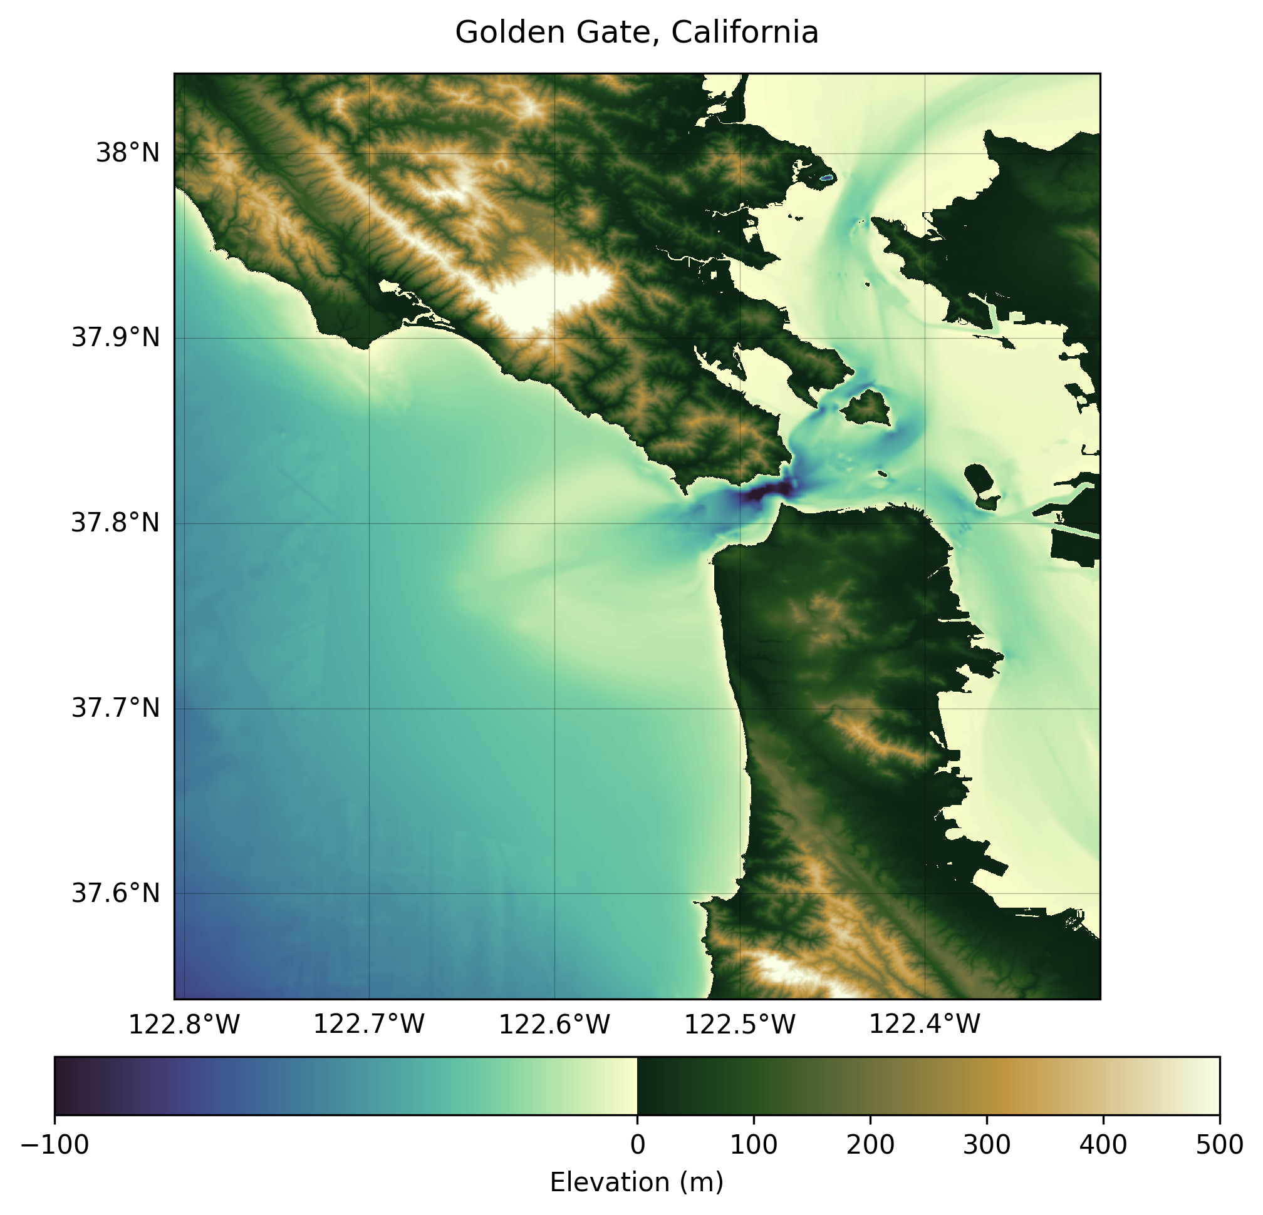
STEP 1: DETERMINE FOUR AREAS OF INTEREST
2. GOLDEN GATE, CALIFORNIA
37°47'35"N 122°33'19"W
Bay mouth formed by tectonic subsidence
Highly energetic, erosional, especially in winter
High turbidity

Slide 5
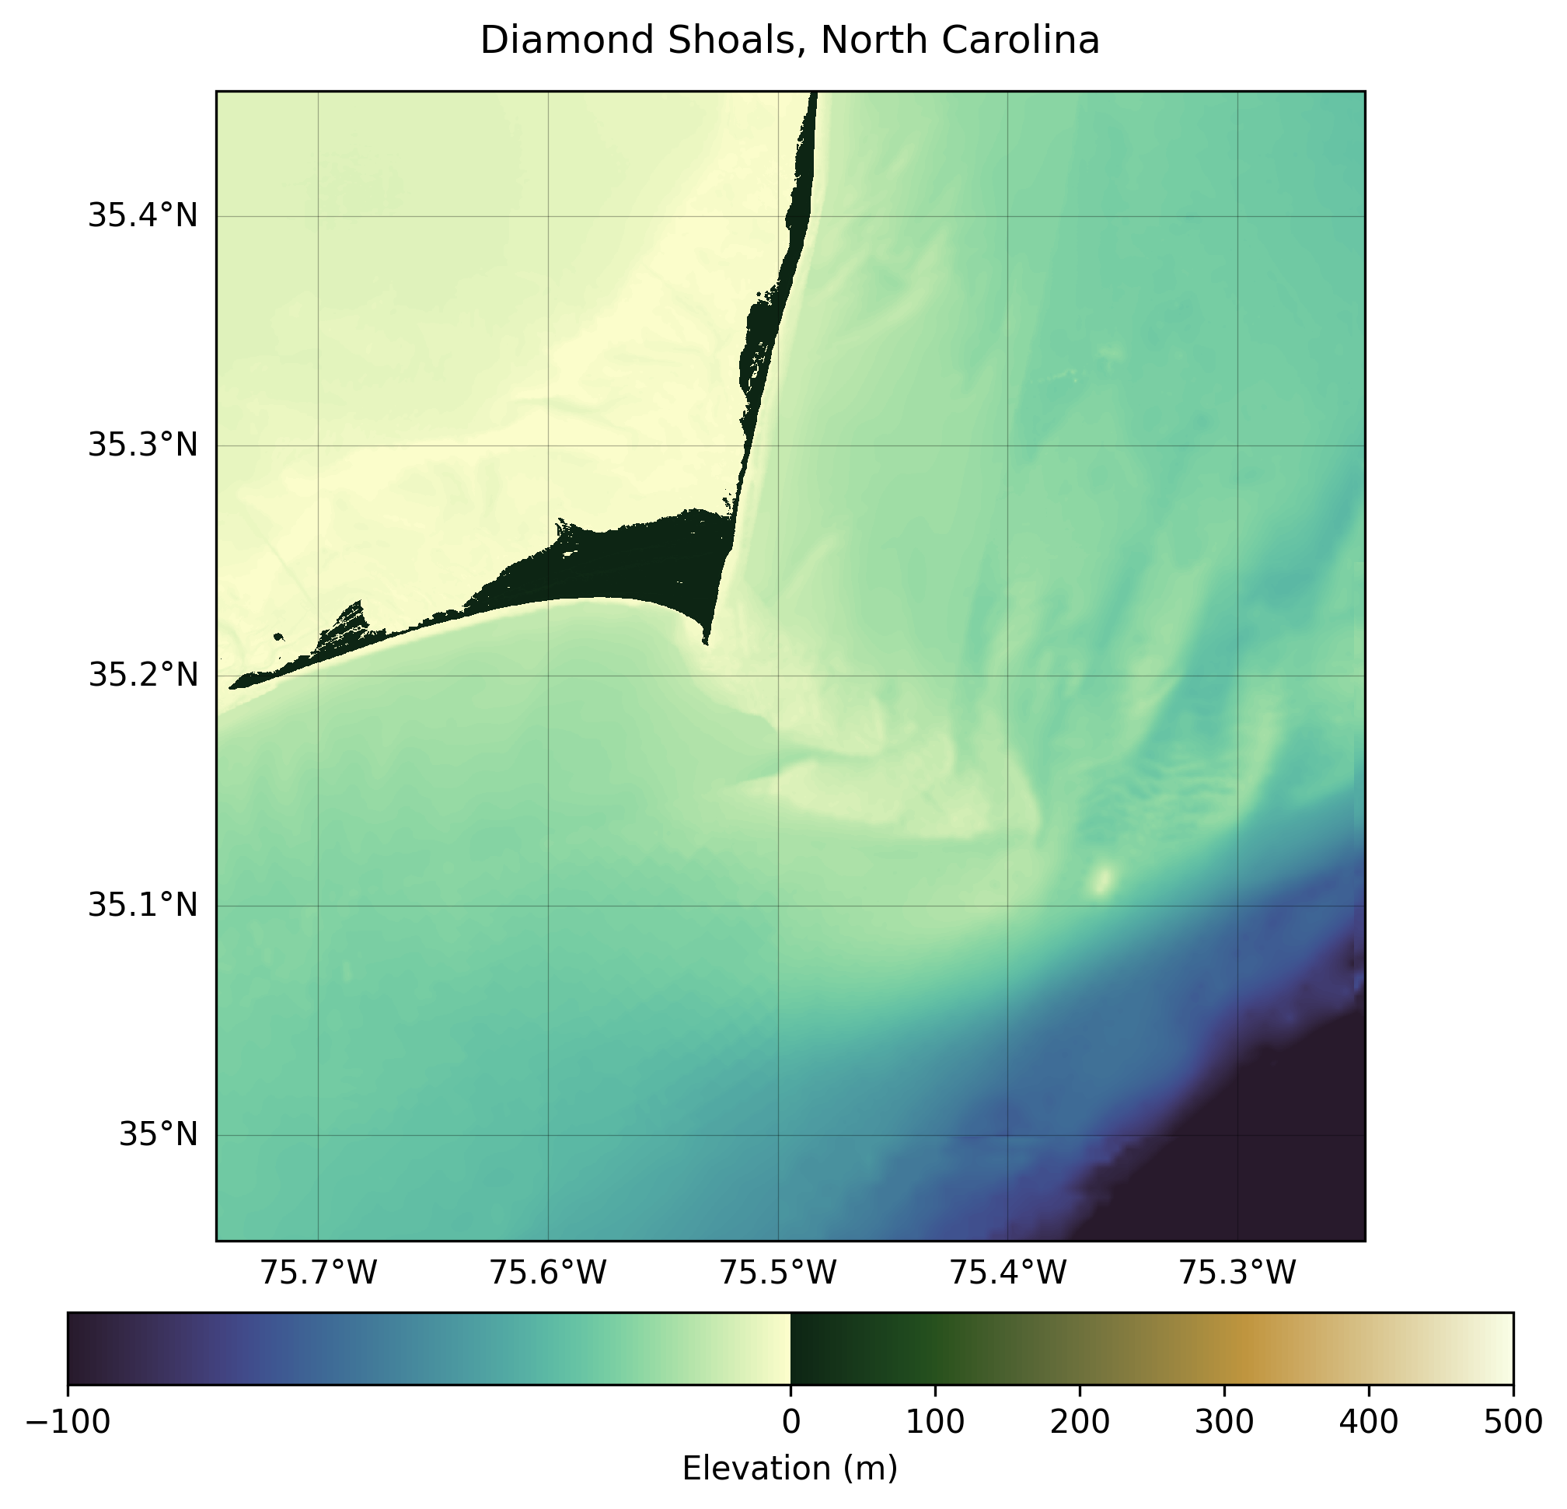
STEP 1: DETERMINE FOUR AREAS OF INTEREST
3. DIAMOND SHOALS, NORTH CAROLINA
35°12'15"N 75°29'40"W
Shifting sandbars that extend 8 miles from shore
Broad continental shelf / slightly sloped relief, depositional coast, lower energy
High turbidity

Slide 6
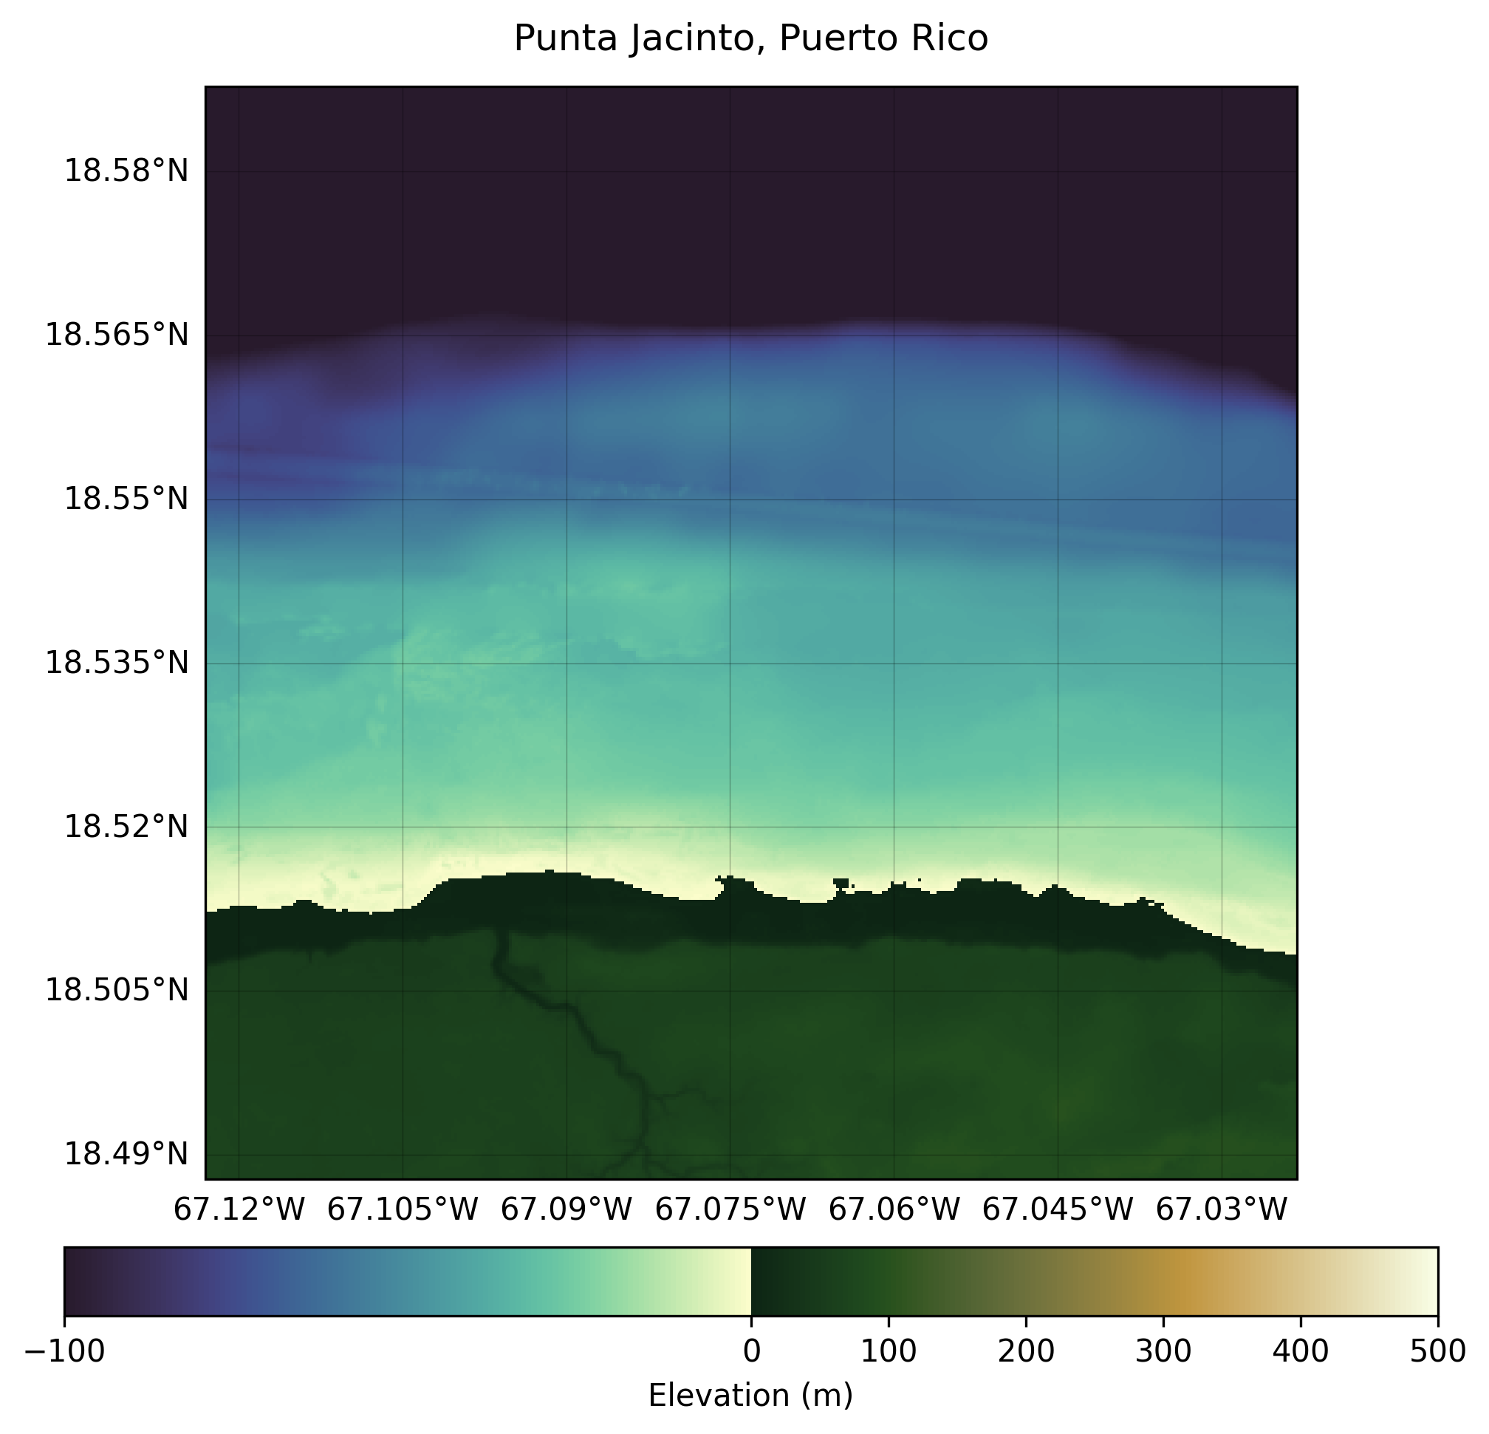
STEP 1: DETERMINE FOUR AREAS OF INTEREST
3. PUNTA JACINTO, PUERTO RICO
18°32'16"N 67°04'23"W
Highly sloped
Moderately energetic in winter, and subject to episodic extreme hurricane events late summer
Mona Canyon just offshore
Low turbidity

Slide 7
STEP 2: LOAD DATA
MINIMUM CONDITIONS FOR DATASET
ADDITIONAL DATA
To be able to perform Wave Kinematics Bathymetry to derive nearshore depth:
Mean significant wave height must be over 1m
Average of the highest one-third (33%) of waves (measured from trough to crest)
Also important to the effectiveness of Wave Kinematics Bathymetry:
Period
Direction

Slide 8
STEP 2: LOAD DATA
A. ESTABLISH AOI CLASS
B. INITIALIZE EACH AOI
class AOI:
name: str
filename: str
lat: str
lon: str
crm_link: str
crm_local: float = "null"
crm_date: str = "null"
bbox_lat: float = 0.25
bbox_lon: float = 0.25
ehukai_lat = dms_to_decimal(degrees = 21, minutes = 40, seconds = 19, direction = "N") # 21°40'19"N
ehukai_lon = dms_to_decimal(degrees = 158, minutes = 3, seconds = 42, direction = "W") # 158°03'42"W
aoi_1 = AOI(name = "North Shore, Oahu, Hawaii",
filename = "ehukai",
lat = ehukai_lat,
lon = ehukai_lon,
bbox_lat = 0.05,
bbox_lon = 0.05,
crm_link = "https://www.ngdc.noaa.gov/thredds/dodsC/crm/cudem/crm_vol10_2023.nc")

Slide 9
STEP 2: LOAD DATA
C. DOWNLOAD CRM FOR EACH AOI, STORE METADATA IN AOI OBJECT
D. DOWNLOAD WAVE MODEL DATA FOR
SEVERAL DAYS AROUND CRM DATE
for a in aoi_list:
local_nc = download_crm(a.crm_link, out_dir="data/crm")
a.crm_local = str(local_nc)
ds = xr.open_dataset(local_nc)
ts_val = ds.attrs.get("GDAL_TIFFTAG_DATETIME")
if ts_val is not None:
ts_str = str(int(ts_val))
date_time = dt.strptime(ts_str, "%Y%m%d%H%M%S")
a.crm_date = str(date_time.date())
else:
date_str = ds.GDAL.split("released")[-1].strip().replace("/", "-")
a.crm_date = date_str
for offset in iterate_offset(max_days):
d = (center_date + timedelta(days=offset)).date()
start_datetime = datetime.combine(d, time.min)
end_datetime = datetime.combine(d, time.max)
subset)dataset_id=ds_name,
variables=["VHM0"],
minimum_longitude=a.lon - a.bbox_lon,
maximum_longitude=a.lon + a.bbox_lon,
minimum_latitude=a.lat - a.bbox_lat,
maximum_latitude=a.lat + a.bbox_lat,
start_datetime=start_datetime,
end_datetime=end_datetime,
output_filename=outpath_d,
)

Slide 10
STEP 2: LOAD DATA
E. FIND DATES WHEN SIGNIFICANT WAVE HEIGHT IS > 1M
F. RECORD AND STORE DATE, SWH, PERIOD, AND SWELL DIRECTION
for a in aoi_list:
center_date = datetime.fromisoformat(str(a.crm_date))
dates_gt1 = []
header = Path(a.filename).stem
for offset in iterate_offset(num_days):
d = (center_date + timedelta(days=offset) + timedelta(days=a.date_offset)).date()
path = dir / f"{header}_wave_{d}.nc"
ds = xr.open_dataset(path)
swh = ds["VHM0"]
swh_avg = float(swh.mean().values)
if swh_avg > 1.0:
date_str = d.strftime("%Y-%m-%d")
dates_gt1.append(date_str)
a.data[date_str] = {
"swh": float(swh.mean().values),
"Period": float(ds["VTPK"].mean().values),
"direction": float(ds["VMDR"].mean().values),
}

Slide 11
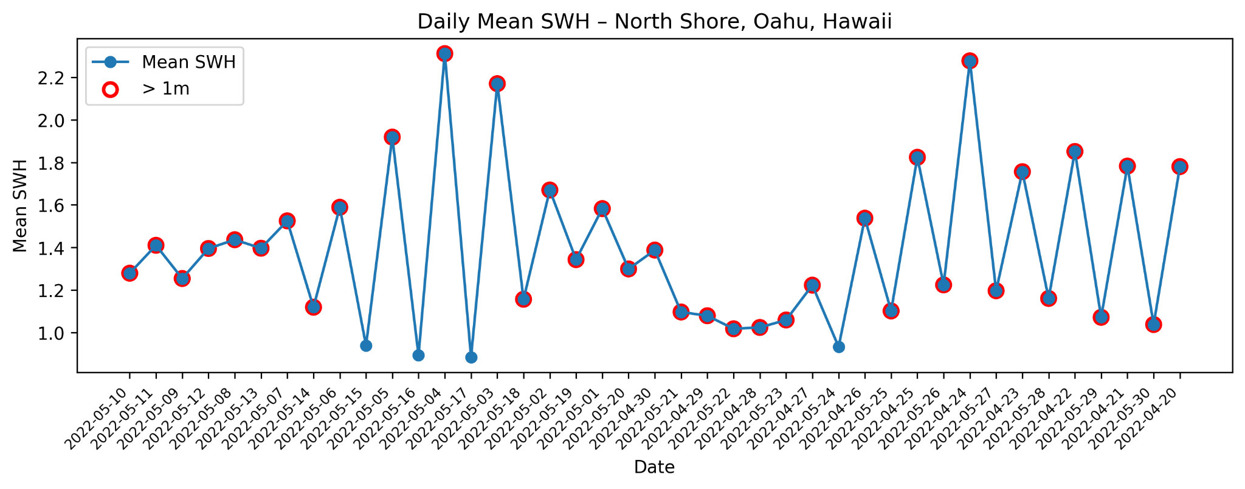
STEP 2: LOAD DATA
EXAMPLE - DAYS ELIGIBLE FOR WAVE KINEMATICS BATHYMETRY

Slide 12
STEP 2: LOAD DATA
G. LOOK FOR SENTINEL-2 DATASETS FROM DAYS WHEN SWH > 1M
H. GET IMAGE WITH LEAST CLOUD COVER, STORE METADATA WITH AOI
for date in swh_dates:
d = datetime.fromisoformat(date).date()
start_of_day = d.strftime("%Y-%m-%d")
datetime_range = f"{start_of_day}/{start_of_day}"
items = list(catalog.search(
collections=["sentinel-2-l2a"],
bbox=bbox,
datetime=datetime_range,
query={"eo:cloud_cover": {"lte": 20}},
limit=50
).items())
if not items:
continue
else:
items_list.append((date, items))
best_item = min(
items,
key=lambda it: it.properties.get("eo:cloud_cover", 100)
found_dates.append(date)
a.data[date]["optical"] = {
"item_id": best_item.id,
"cloud_cover": best_item.properties.get("eo:cloud_cover", 100),
"sun_azimuth": best_item.properties.get("view:sun_azimuth"),
"sun_elevation": best_item.properties.get("view:sun_elevation"),
}

Slide 13
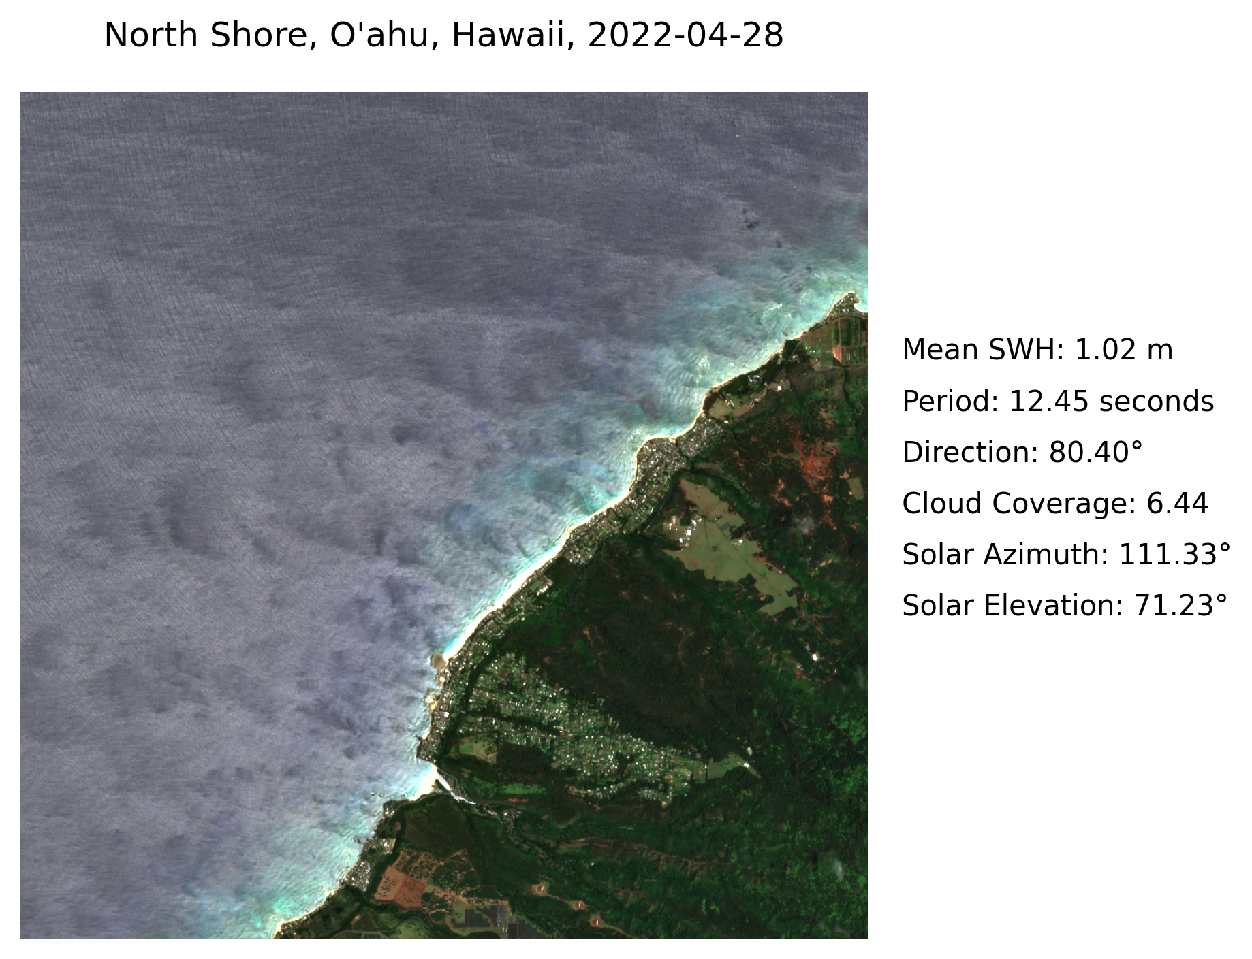
STEP 2: LOAD DATA
I. SELECT AN IMAGE FOR WAVE KINEMATICS BATHYMETRY
Visibility of surface features enhanced by sun glint/glitter, so we want:
Waves traveling toward sun
In example, sun to east, waves traveling east.
Solar elevation between 20° - 70°

